Slide 1
Teaching
简约教学通用模板
教师说课│公开课│示范课│教师授课
The top "Start" panel allows you to modify the font, size, color, line spacing, and more. It is recommended that the text be 8 to 18 characters with 1.3 times the space between the characters.
授课人：明月

Slide 2
壹
知识点讲解
Selected topic background
Directory
贰
总结与归纳
课程目录
Selected topic background
The top "Start" panel allows you to modify the font, size, color, line spacing, and more.
叁
课堂检测
Selected topic background
肆
课后作业
Selected topic background

Slide 3
conclusion
ONE
知识点讲解
The top "Start" panel allows you to modify the font, size, color, line spacing, and more. It is recommended that the text be 8 to 18 characters with 1.3 times the space between the characters.

Slide 4
知识点讲解
Unified fonts
make reading more fluent.
01
Theme color makes PPT more convenient to change. Adjust the spacing to adapt to Chinese typesetting, use the reference line in PPT.
02
Theme color makes PPT more convenient to change. Adjust the spacing to adapt to Chinese typesetting, use the reference line in PPT.
03
Theme color makes PPT more convenient to change. Adjust the spacing to adapt to Chinese typesetting, use the reference line in PPT.

Slide 5
知识点讲解
01.
Theme color makes PPT more convenient to change. Adjust the spacing to adapt to Chinese typesetting, use the reference line in PPT.
02.
Theme color makes PPT more convenient to change. Adjust the spacing to adapt to Chinese typesetting, use the reference line in PPT.
03.
Theme color makes PPT more convenient to change. Adjust the spacing to adapt to Chinese typesetting, use the reference line in PPT.

Slide 6
知识点讲解
Unified fonts make reading more fluent.
Theme color makes PPT more convenient to change. Adjust the spacing to adapt to Chinese typesetting, use the reference line in PPT.Theme color makes PPT more convenient to change. Adjust the spacing to adapt to Chinese typesetting, use the reference line in PPT.
01.
Theme color makes PPT more convenient to change. Adjust the spacing
02.
Theme color makes PPT more convenient to change. Adjust the spacing
03.
Theme color makes PPT more convenient to change. Adjust the spacing
04.
Theme color makes PPT more convenient to change. Adjust the spacing

Slide 7
conclusion
TWO
总结与归纳
The top "Start" panel allows you to modify the font, size, color, line spacing, and more. It is recommended that the text be 8 to 18 characters with 1.3 times the space between the characters.

Slide 8
总结与归纳
Unified fonts make reading
mor e fluent.
Text here
Theme color makes PPT more convenient to change.
Adjust the spacing to adapt to Chinese typesetting, use the reference line in PPT.
Text here
Theme color makes PPT more convenient to change.
Adjust the spacing to adapt to Chinese typesetting, use the reference line in PPT.
Theme color makes PPT more convenient to change.Adjust the spacing to adapt to Chinese typesetting, use the reference line in PPT.Unified fonts make reading more fluent.Copy paste fonts. Choose the only optio to retain

Slide 9
总结与归纳
Unified fonts
make reading more fluent.
TEXT HERE
TEXT HERE
Adjust the spacing to adapt to Chinese typesetting, use the reference line in PPT.
Adjust the spacing to adapt to Chinese typesetting, use the reference line in PPT.
Adjust the spacing to adapt to Chinese typesetting, use threference line in PPT.Unified fonts make reading more fluent.Copy paste fonts. Choose the only optio to retain text……
TEXT HERE
TEXT HERE
Adjust the spacing to adapt to Chinese typesetting, use the reference line in PPT.
Adjust the spacing to adapt to Chinese typesetting, use the reference line in PPT.

Slide 10
总结与归纳
Unified fonts
Theme color makes PPT more convenient to change.
Adjust the spacing to adapt to Chinese typesetting, use the reference line in PPT.
Unified fonts
Theme color makes PPT more convenient to change.
Adjust the spacing to adapt to Chinese typesetting, use the reference line in PPT.
Unified fonts
Theme color makes PPT more convenient to change.
Adjust the spacing to adapt to Chinese typesetting, use the reference line in PPT.

Slide 11
conclusion
THREE
课堂检测
The top "Start" panel allows you to modify the font, size, color, line spacing, and more. It is recommended that the text be 8 to 18 characters with 1.3 times the space between the characters.

Slide 12
课堂检测
Theme color makes PPT more convenient to change.
Adjust the spacing to adapt to Chinese typesetting, use the reference line in PPT.
Theme color makes PPT more convenient to change.
Adjust the spacing to adapt to Chinese typesetting, use the reference line in PPT.
Theme color makes PPT more convenient to change.
Adjust the spacing to adapt to Chinese typesetting, use the reference line in PPT.
Theme color makes PPT more convenient to change.
Adjust the spacing to adapt to Chinese typesetting, use the reference line in PPT.

Slide 13
课堂检测
Supporting text here.
text here
Theme color makes PPT more convenient to change.
Theme color makes PPT more convenient to change.Theme color makes PPT more convenient to change.
Theme color makes PPT more convenient to change.
Theme color makes PPT more convenient to change.
text here
Theme color makes PPT more convenient to change.
text here
Theme color makes PPT more convenient to change.

Slide 14
课堂检测
01
Supporting Text Here.
Theme color makes PPT more convenient to change. the spacing to adapt to Chinese typesetting. Theme color makes PPT more to change.djust the spacing to adapt Chinese typesetting.
Supporting Text Here.
02
Theme color makes PPT more convenient to change. the spacing to adapt to Chinese typesetting. Theme color makes PPT more to change.djust the spacing to adapt Chinese typesetting.

Slide 15
conclusion
FOUR
课后作业
The top "Start" panel allows you to modify the font, size, color, line spacing, and more. It is recommended that the text be 8 to 18 characters with 1.3 times the space between the characters.

Slide 16
课后作业
01.
02.
03.
04.
Theme color makes PPT more convenient to change.Adjust the spacing to adapt to Chinese typesetting, use the reference line in PPT.
Theme color makes PPT more convenient to change.Adjust the spacing to adapt to Chinese typesetting, use the reference line in PPT.
Theme color makes PPT more convenient to change.Adjust the spacing to adapt to Chinese typesetting, use the reference line in PPT.
Theme color makes PPT more convenient to change.Adjust the spacing to adapt to Chinese typesetting, use the reference line in PPT.

Slide 17
课后作业
01.
02.
text here
text here
Theme color makes PPT more convenient to change.
Theme color makes PPT more convenient to change.
03.
04.
text here
text here
Theme color makes PPT more convenient to change.
Theme color makes PPT more convenient to change.

Slide 18
课后作业
Unified fonts
Unified fonts
Theme color makes PPT more convenient to change.
Adjust the spacing to adapt to Chinese typesetting, use the reference line in PPT.
Theme color makes PPT more convenient to change.
Adjust the spacing to adapt to Chinese typesetting, use the reference line in PPT.

Slide 19
Teaching
演示结束 谢谢观看
教师说课│公开课│示范课│教师授课
The top "Start" panel allows you to modify the font, size, color, line spacing, and more. It is recommended that the text be 8 to 18 characters with 1.3 times the space between the characters.
授课人：明月

Slide 20
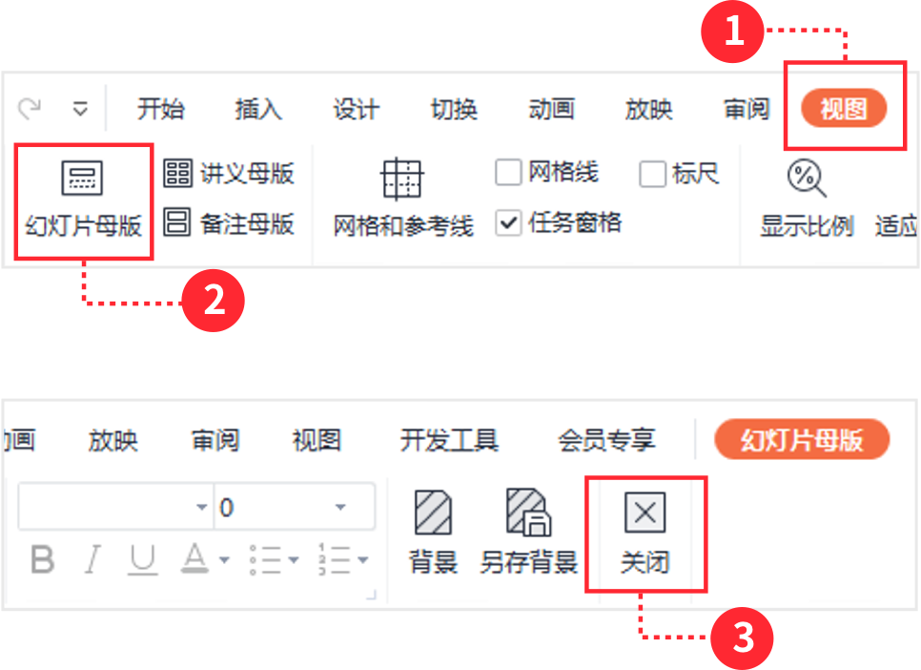
稻壳儿PPT模板使用说明
（本页为说明页，用户使用模板时可删除本页内容）
01
字体说明
02
素材说明
03
母版说明
中文｜字体名称
图片：
使用本套PPT模板时，若在操作界面鼠标不可选取的内容，可以在幻灯片母版中进行查看和编辑，具体操作如下：
汉仪宋韵朗黑W
模板中使用的图片来源于【unsplash】，该图片具有CC0共享协议，您可在遵循CC0共享协议的情况下使用。
1、点击【视图】
2、选择【幻灯片母版】，即可查看母版内容
3、查看/编辑完成后，点击【关闭】即可
中文｜字体名称
素材：
汉仪宋韵朗黑W
模板中使用的素材来源于【freepik】，该素材具有CC0共享协议，您可在遵循CC0共享协议的情况下使用。
英文｜字体名称
汉仪宋韵朗黑W
【说明】
模板中使用的字体仅限于个人学习、研究或欣赏目的使用，如需商用请您自行向版权方购买、获取商用版权。

